Slide 1
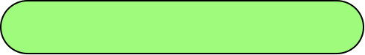



Capstone Design Project
Midterm Progress
Perfect StudyMate
Team k
Juyong Rhee | Yewon Chun | Jihee Hwang | Jorge Alcorta

Slide 2
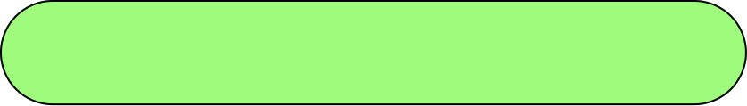



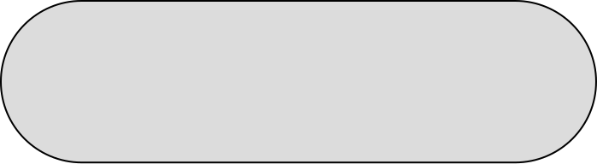

Why Perfect StudyMate?
But ChatGPT is…
Where is the content
I'm looking for in this
super thick textbook?
General Answers
ChatGPT generate answers which is not based on student’s lecture sources. It just generates general level answers.
Hallucination
Many students feel uncomfortable with
the textbook-centered study and
use ChatGPT a lot as a tool for learning.
ChatGPT sometimes generate a fake response
as it is truth.
Problem situation 1
Problem situation 2

Slide 3
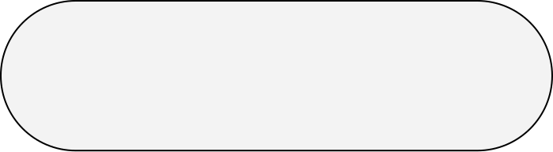
This is The Reason Why We need
Customized Chatbot to support students!
Why Perfect StudyMate?
But ChatGPT is…
General Answers
Where is the content
I'm looking for in this
super thick textbook?
ChatGPT generate answers which is not based on student’s lecture sources. It just generates general level answers.
Prior Context Effect
ChatGPT’s responses are influenced by prior conversational effect. It means it can generate wrong response.
Many students feel uncomfortable with
the textbook-centered study and
use ChatGPT a lot as a tool for learning.
Hallucination
ChatGPT sometimes generate a false response
as it is truth.
Problem situation 1
Problem situation 2

Slide 4
Milestone
 | Week5 | Week6 | Week7 | Week8 | Week9 | Week10 | Week11 | Week12 | Week13
Langchain & RAG Study
AI Structure Design
AI Architecture Development
Database Design
API Specification
API Integration
API Implementation
UI/UX Design
FrontEnd Implementation
Integration Testing
Feedback was made on each other's work during the development process.

Slide 5








Role Division
Juyong Rhee
Yewon Chun
- Team Leader
- BackEnd Development
AI Model Development
Documentation
Jihee Hwang
Jorge Alcorta
UI/UX Designmer
FrontEnd Development
AI Model Development
Presentation

Slide 6
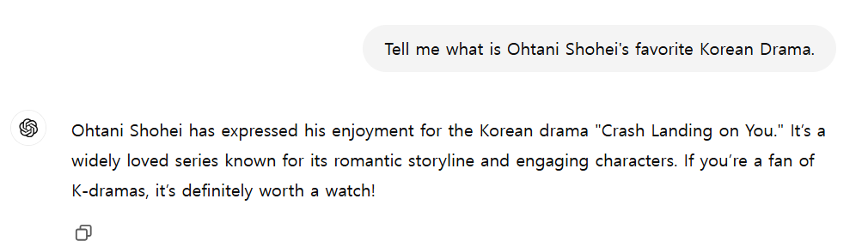

AI Model Development
RAG (Retrieval-Augmented Generation)
Simply, it is a technique for generating reliable responses by checking reference resources
other than LLM data sources to generate chatbot responses.
By Using RAG technique, our chatbot can generate answers with lower hallucination.
Example of Hallucination

Slide 7

AI Model Development
Langchain
An open source framework for building applications based on large language models (LLMs).
It is possible to develop models in a modularized manner by using various document loaders and embedding models provided by Langchain.

Slide 8
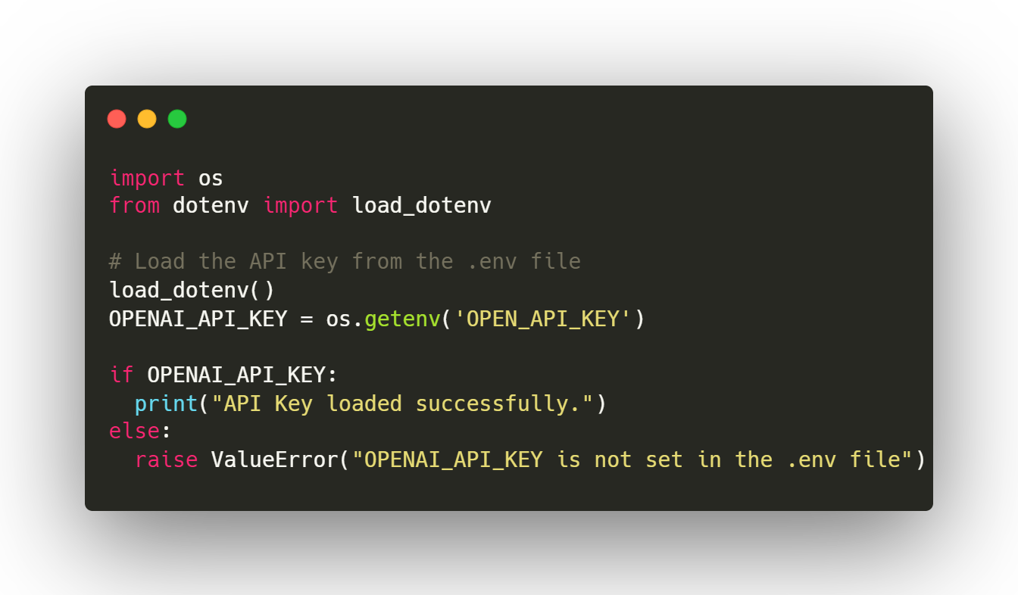
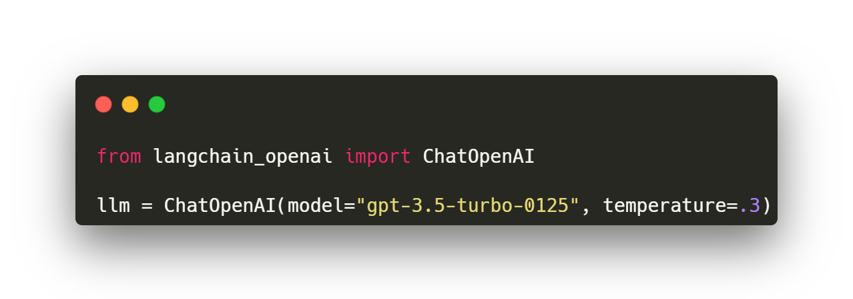
AI Model Development
Code Overview & Functionalities
▲ Create Large Language Model (LLM) Object
OpenAPI provides various version of ChatOpenAI. But we choose version of : GPT-3.5-turbo-0125

Slide 9
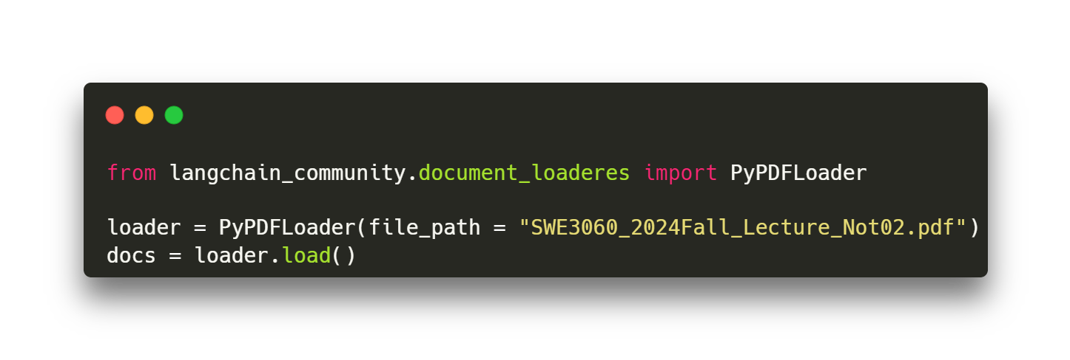
AI Model Development
Code Overview & Functionalities
▲ Load Example .pdf File for RAG
We use PyPDFLoader for loading documents on model in this baseline code.
It is pretty fast because it is a rule-based document loader!

Slide 10
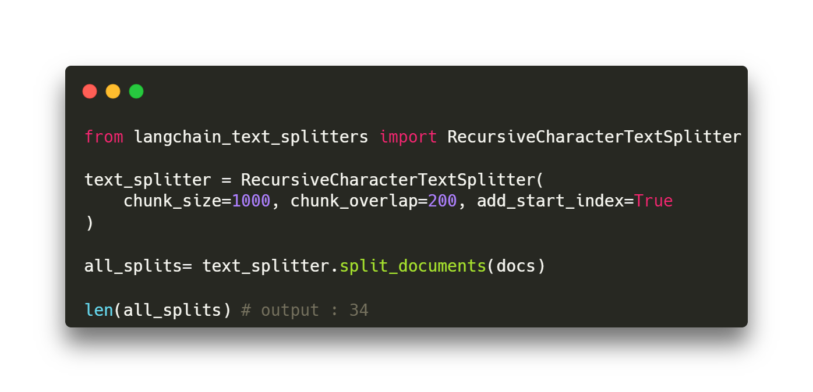
AI Model Development
Code Overview & Functionalities
We use RecursiveCharacterTextSplitter
for split our loaded documents.
We’re going to try another splitter algorithms soon and compare the performances!
▲ Chunk loaded documents

Slide 11


AI Model Development
Vector Database
The vector database is specialized in storing vector-type data and quickly calculating their similarity.
Because of this powerful advantage, vector databases are mainly used to store natural languagedata.
We choose ChromaDB as a vector Database
1. Ease of use and Setup
- just type pip install chromadb !
2. High Integrity with other frameworks
3. Full-featured
- vector search, document storage, metadata filtering, multi-modal retrieval …

Slide 12
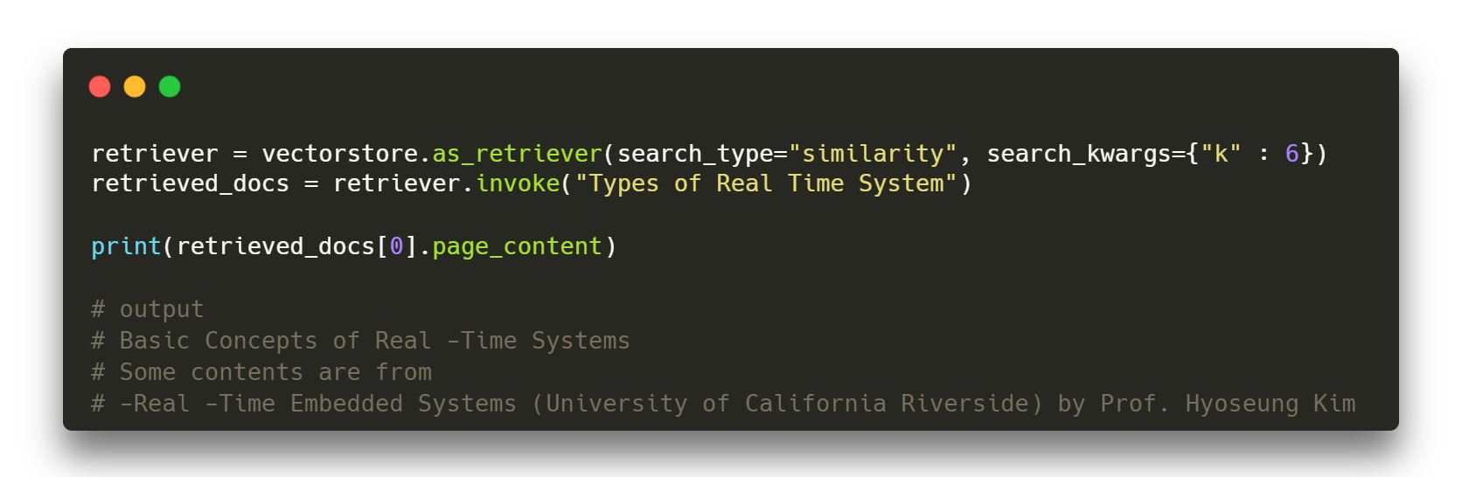
AI Model Development
Code Overview & Functionalities
A code was executed to receive responses from the database by a simple question.

Slide 13
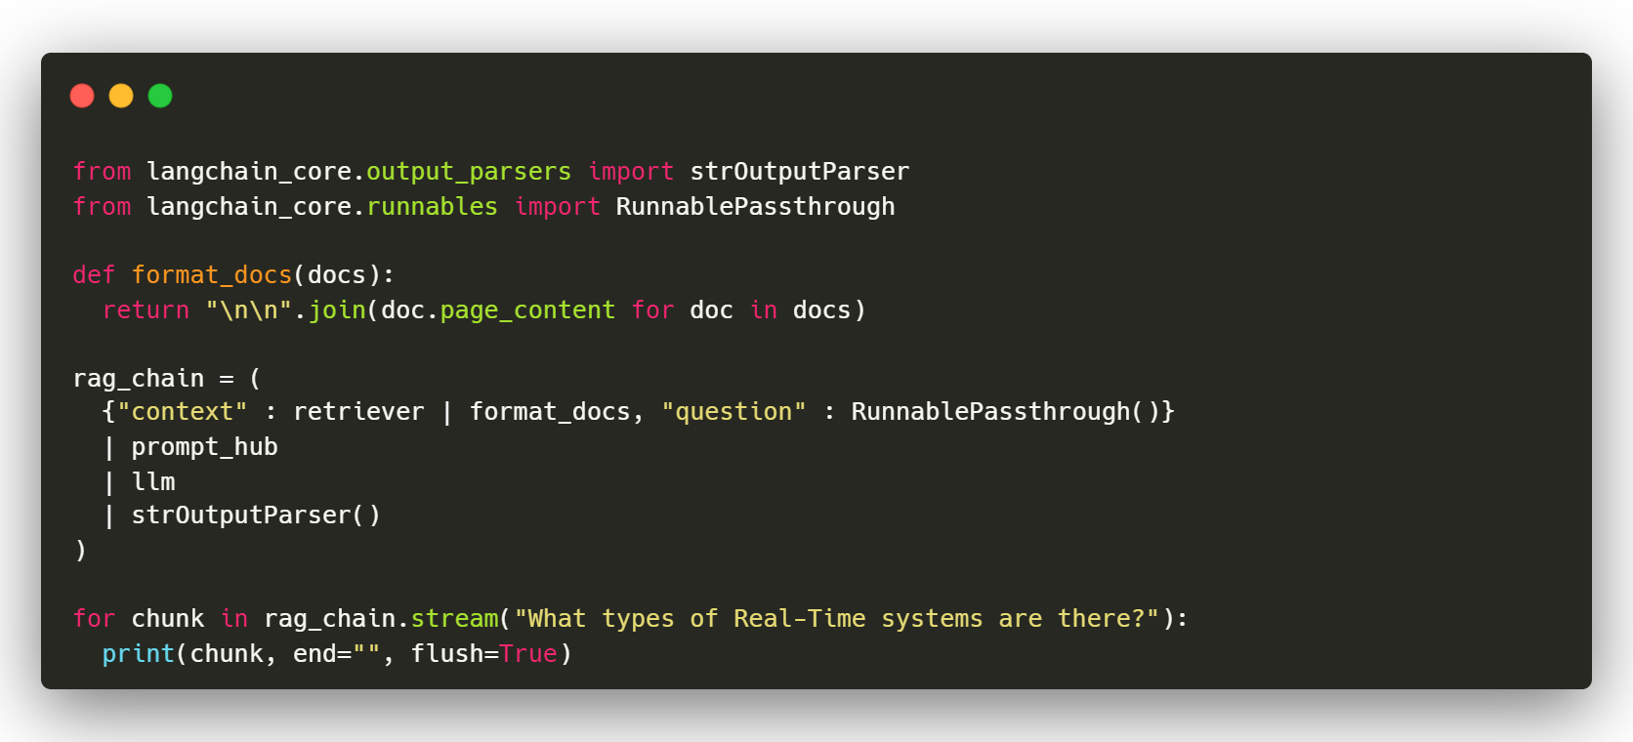
AI Model Development
Code Overview & Functionalities
Document
Loader
Document
Splitter
Context from
VectorDB
Vector
Embedding
By Combining basic features via Langchain. This is our Baseline model for RAG.

Slide 14
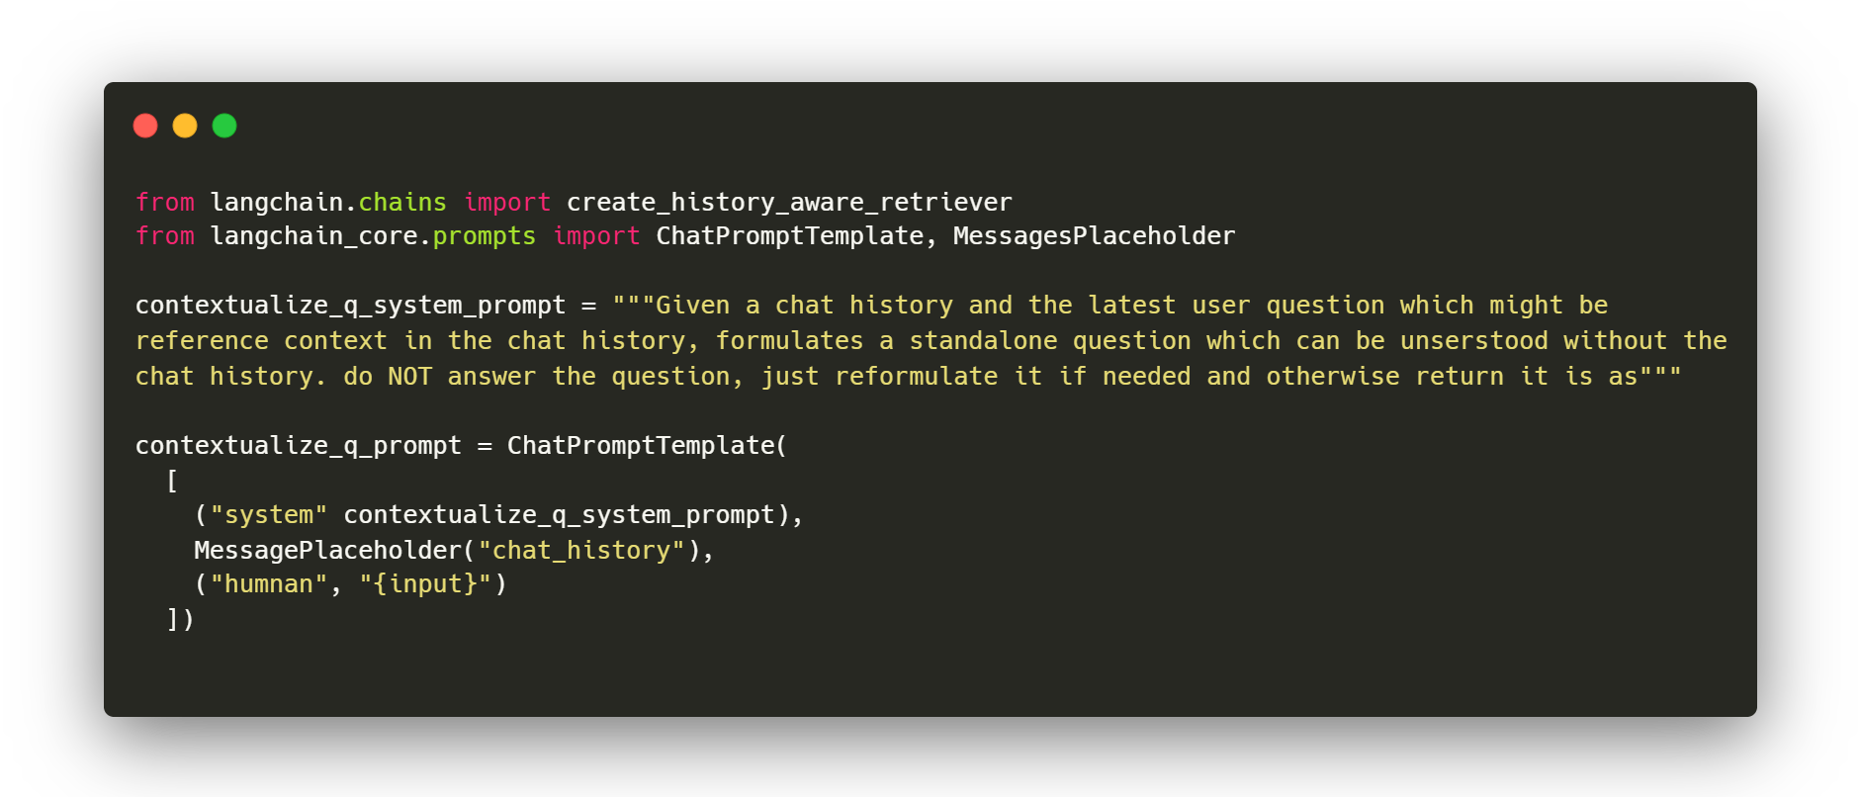

AI Model Improvement
Chat History – contextualizing the question
The chat history is vital for continuity in conversations, allowing the model to maintain context across multiple interactions with the user, and allowing the user to make follow-up questions in case they don’t understand any previous explanations.

Slide 15
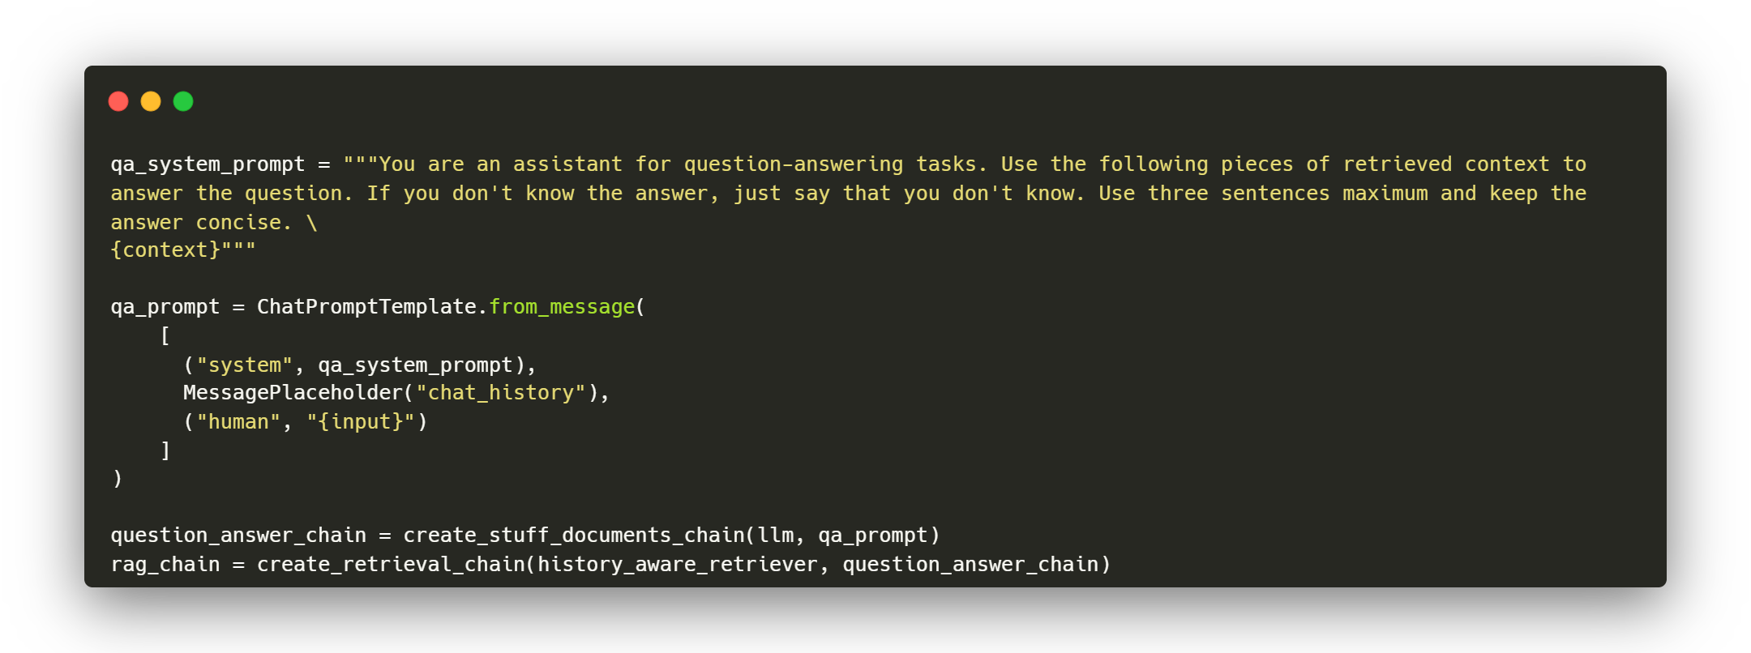
AI Model Improvement
Chat History – answer question with context
The system takes the context into account when generating the answer.

Slide 16


AI Model Improvement
Few shot Prompting
Few-shot prompting provides the model with structured examples, teaching it the correct response format and encouraging it to focus on relevant details. This is crucial in educational contexts where the generated content must align closely with specific course material, ensuring the quiz questions are accurate, contextual, and relevant.
Give the antonym of input.
Input : surprised
Output : calm
Input : satisfied
Output : dissatisfied
Input : excited
based on prompt,
"antonym" of input is "bored"!

Slide 17
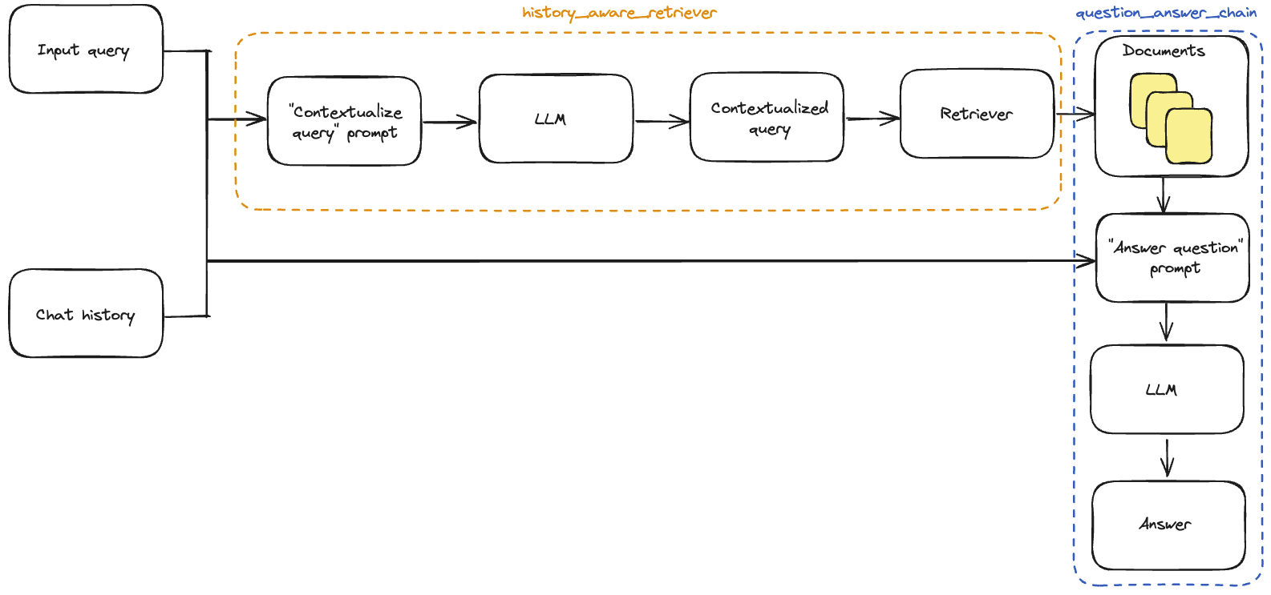
AI Model Improvement
History_aware_retriever
Question_answer_chain
Input query
“contextualize query”
prompt
LLM
Contextualized
query
Retriever
“answer question”
prompt
Chat
History
LLM
Answer

Slide 18

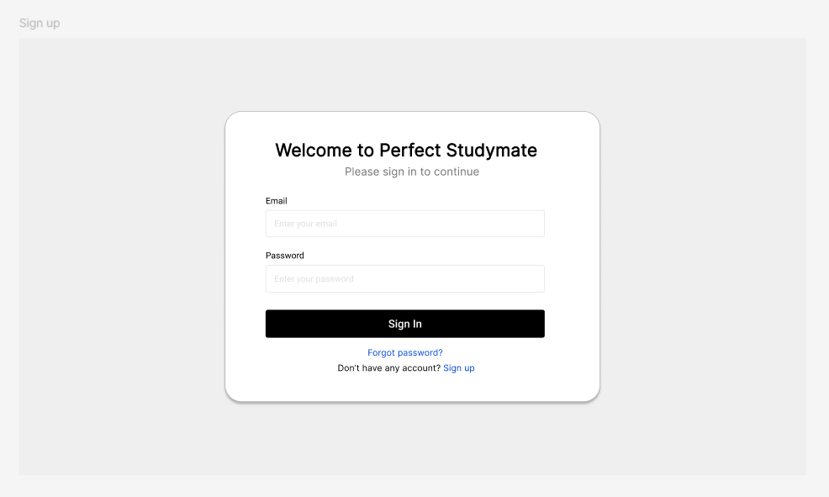
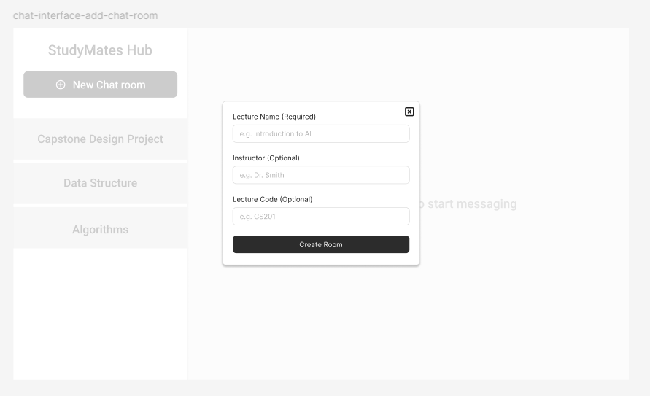
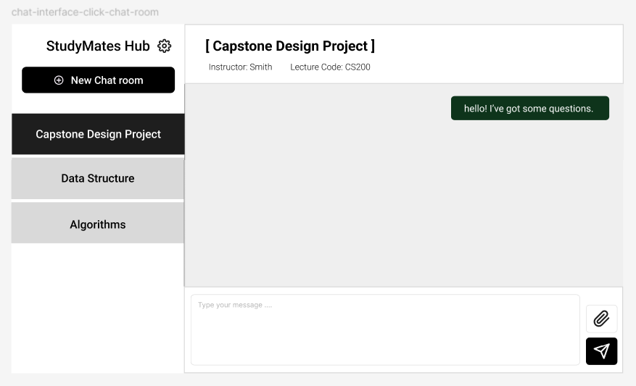
FrontEnd
Figma Demo
Create Demo frontend UI/UX using figma. And check functionalities we need to implement.

Slide 19
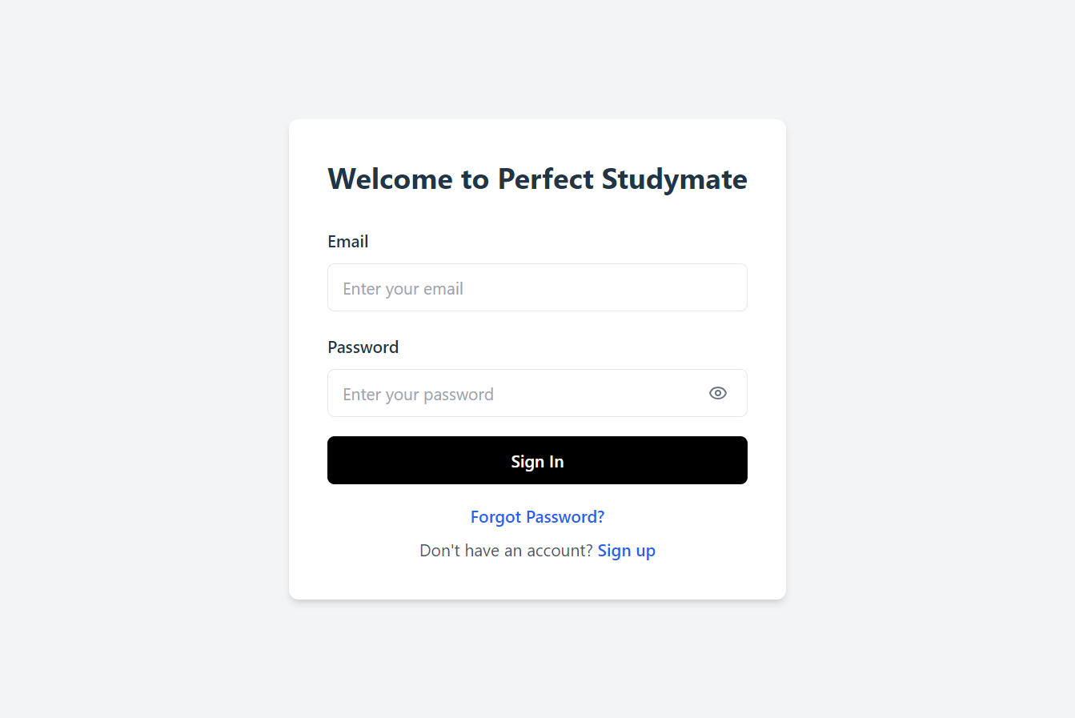
FrontEnd
Login Page
Responsible for handling user login.
It includes a form where the user can enter their email and password with options to toggle the password visibility and submit the form.
After successfully logging in, the user is redirected to the chat interface.
▲login.jsx

Slide 20
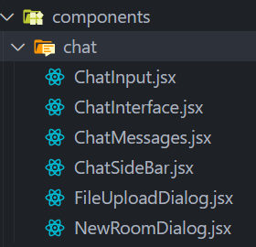
FrontEnd
Chat Interface Page
An interface for users to send/receive messages.
Chat room selection and management. A list of available chat rooms is displayed in the screen sidebar.
User can create new chat room by clicking “New Chat Room” button and entering chatroom creation modal popup.
User can sending messages
▲ Components of Chat Interface Page

Slide 21

FrontEnd
FrontEnd Demo Video

Slide 22
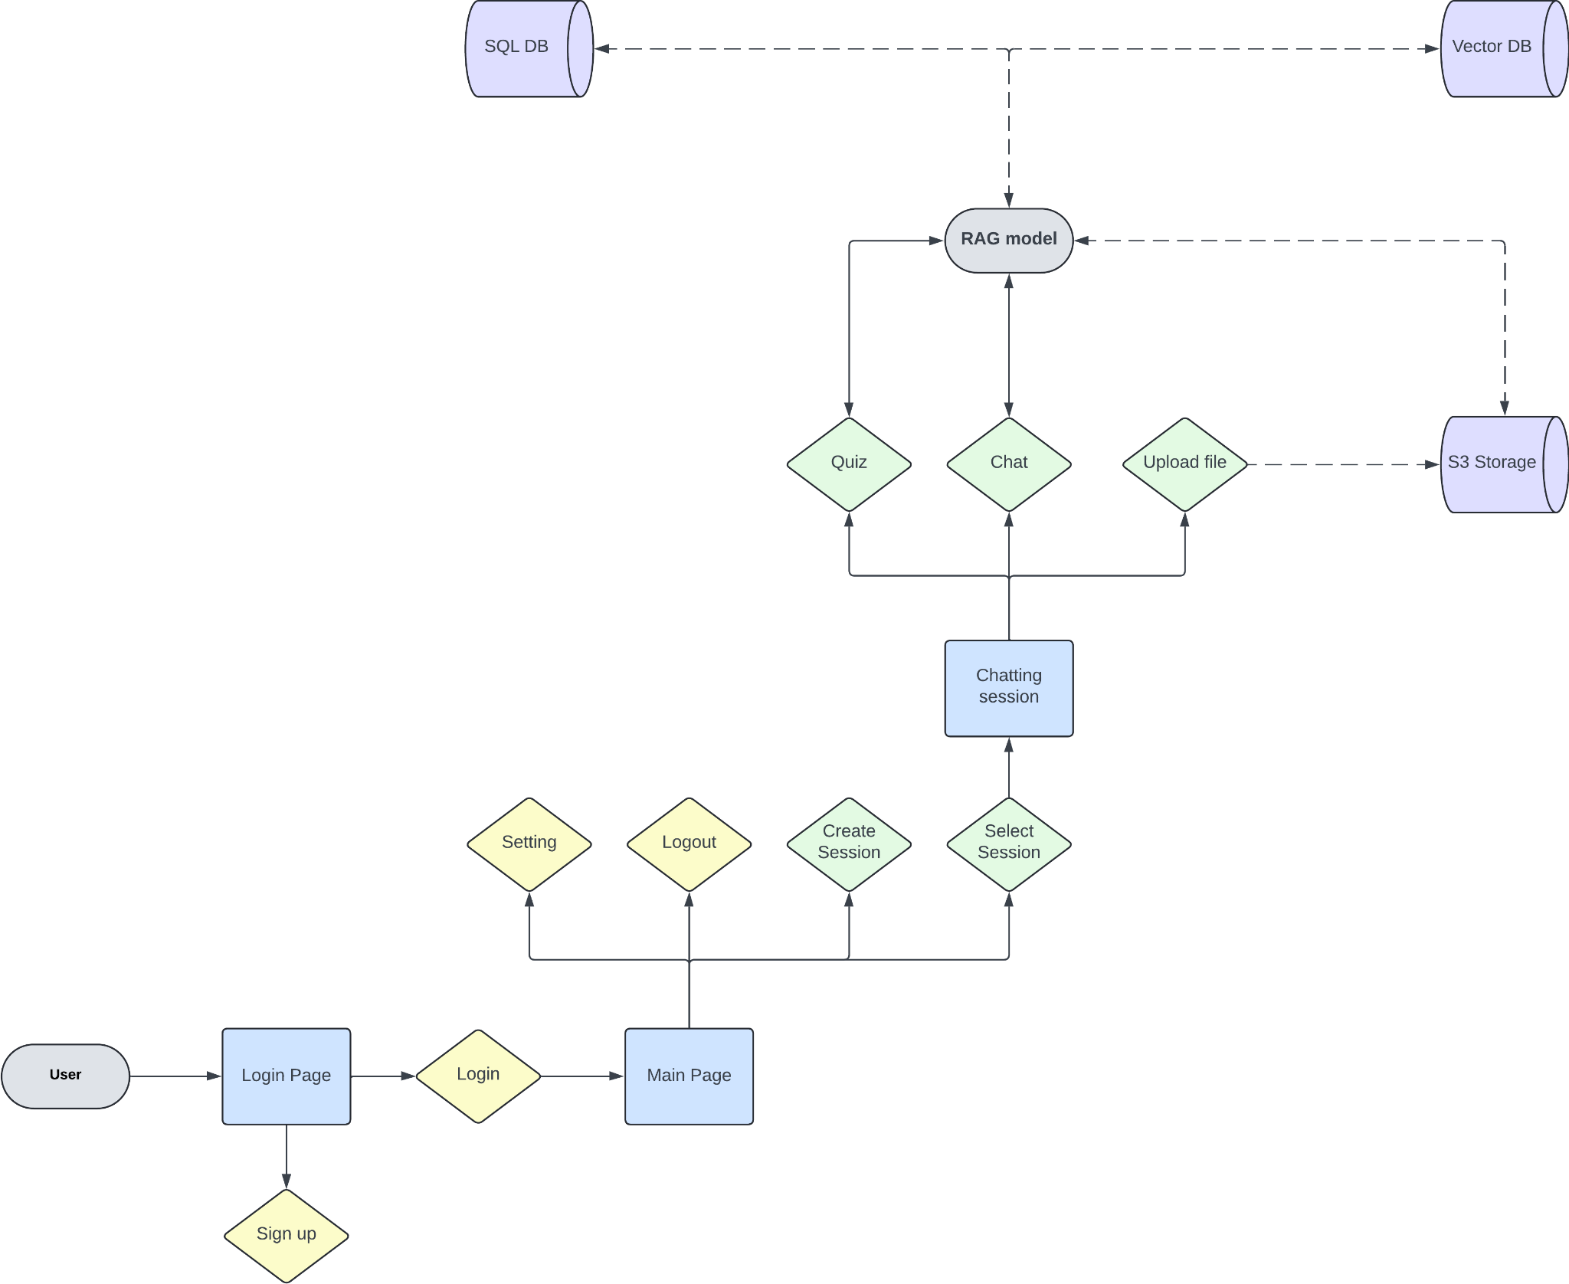
BackEnd
BackEnd Design

Slide 23
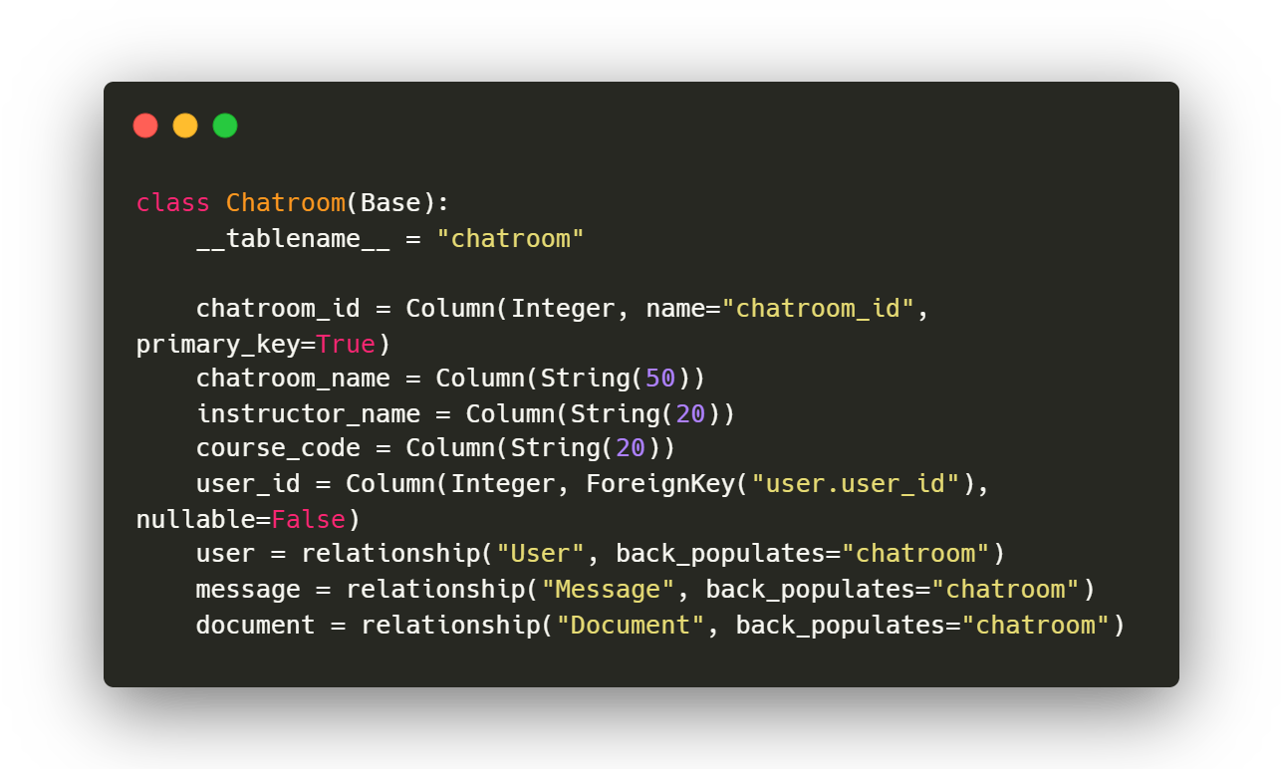
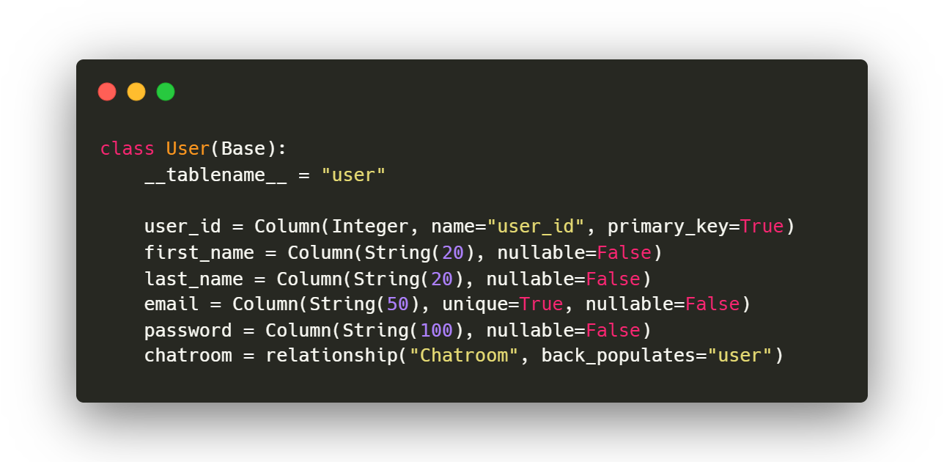
BackEnd
DataBase Schema
▲ User Schema
▲ Chatroom Schema

Slide 24
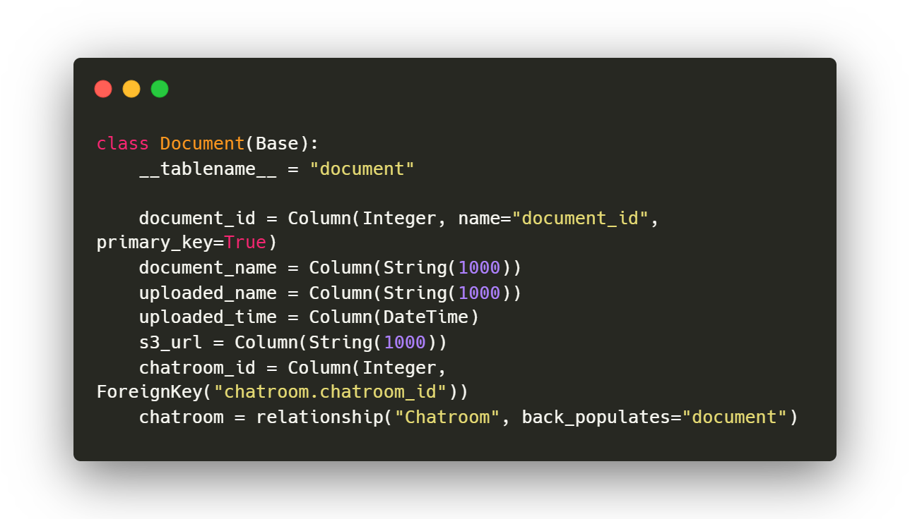
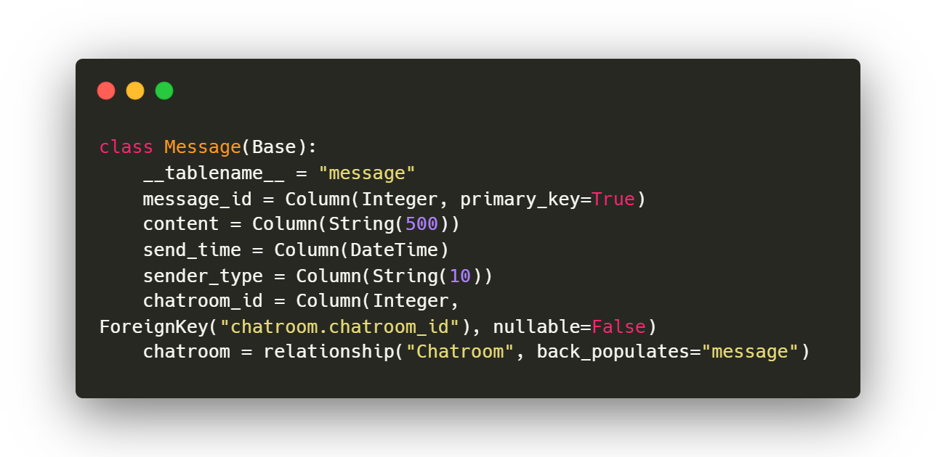
BackEnd
DataBase Schema
▲ Message Schema
▲ Document Schema

Slide 25
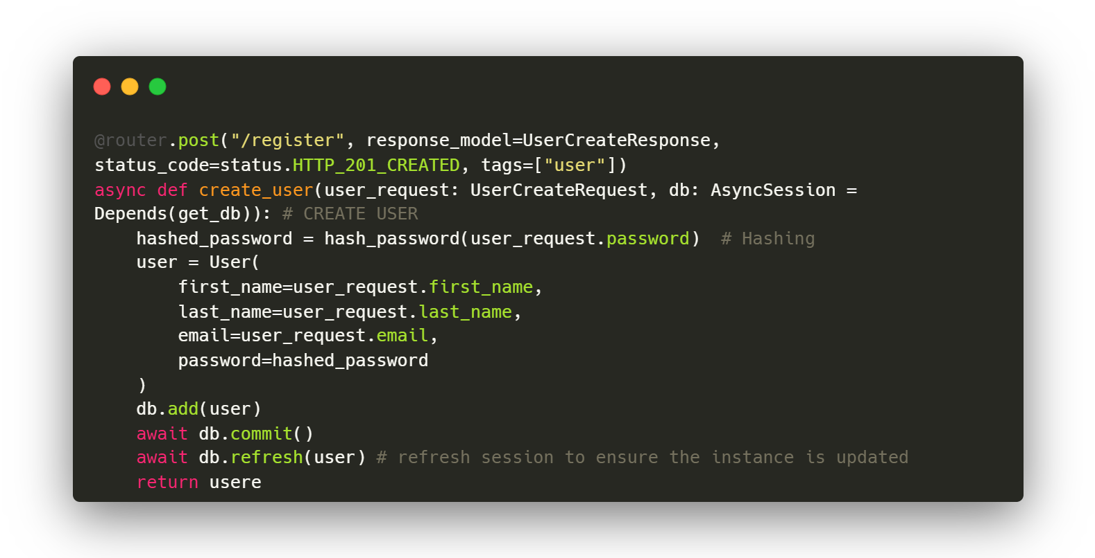
BackEnd
(Example) User | Register
Hash
Password
Create
User Object
Store
In DB
Respond
With user

Slide 26
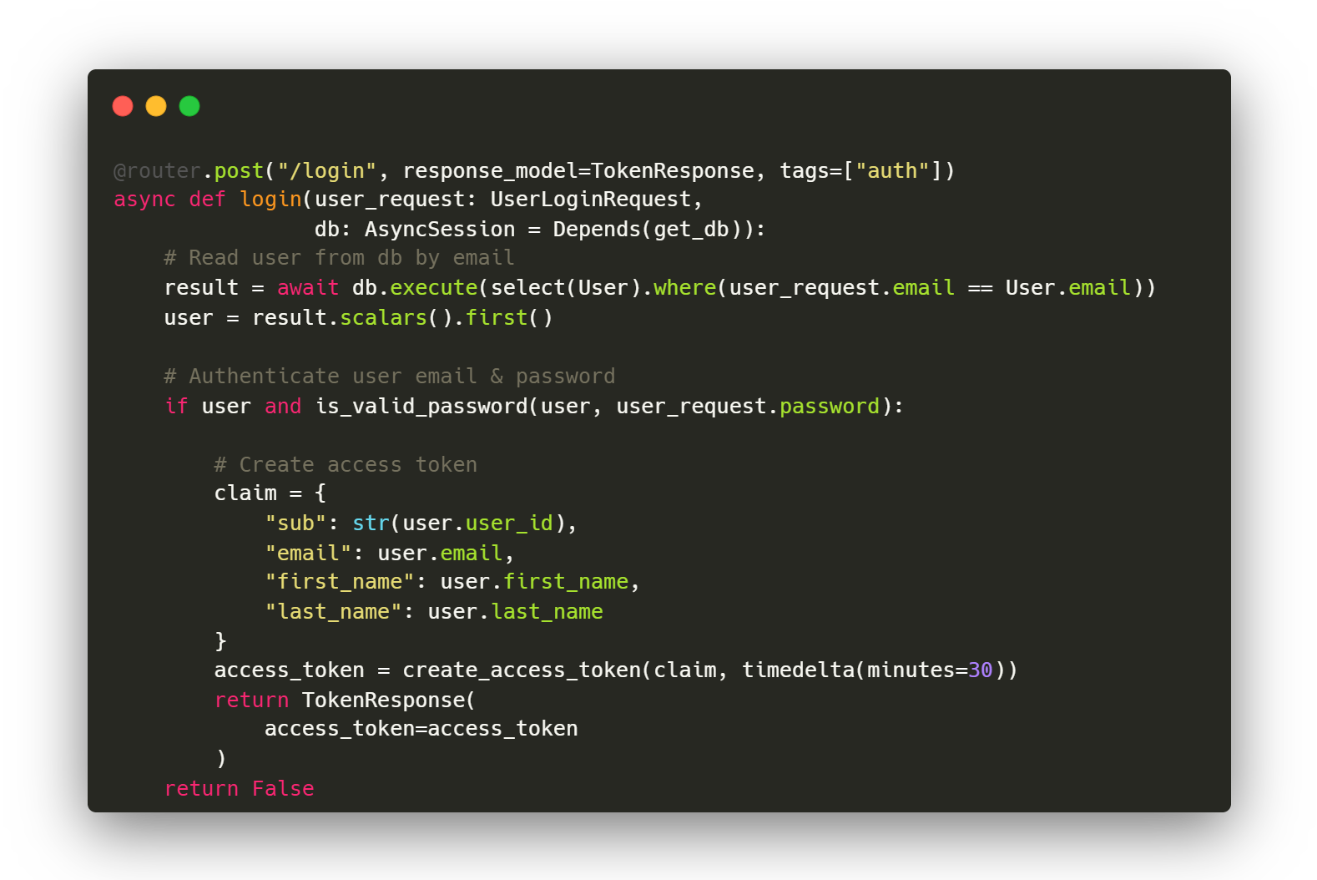
BackEnd
(Example) Auth | login
Find
user from
DB
Validate
user
Create
Access token
Respond
With token

Slide 27

BackEnd
GET request
POST request
DELETE request
User
Chatroom
Message
Document
/user/register
/chatroom/create
/message/{chatroom_id}
/document/{chatroom_id}
/user/{user_id}
/chatroom/
/message/{chatroom_id}
/document/{chatroom_id}
/chatroom/{chatroom_id)
/document/{chatroom_id}/
{document_id}
/chatroom/{chatroom_id)

Slide 28
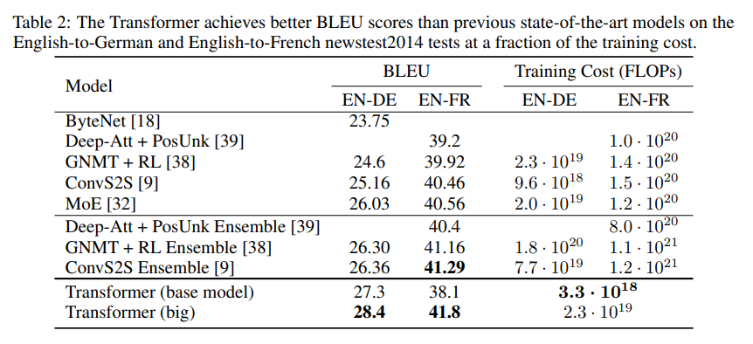
Challenges
PyPDFLoader cannot load tabular data …
Model
BLEU Training Cost (FLOPs)
EN-DE EN-FR EN-DE EN-FR
ByteNet [18] 23.75
Deep-Att + PosUnk [39] 39.2 1.0 · 1020
GNMT + RL [38] 24.6 39.92 2.3 · 1019 1.4 · 1020
ConvS2S [9] 25.16 40.46 9.6 · 1018 1.5 · 1020
MoE [32] 26.03 40.56 2.0 · 1019 1.2 · 1020
Deep-Att + PosUnk Ensemble [39] 40.4 8.0 · 1020
GNMT + RL Ensemble [38] 26.30 41.16 1.8 · 1020 1.1 · 1021
ConvS2S Ensemble [9] 26.36 41.29 7.7 · 1019 1.2 · 1021
Transformer (base model) 27.3 38.1 3.3 · 1018
…
Result of PyPDFLoader ▶
Our basic PDFloader (PyPDFLoader) Cannot read and parse table structure well.
The Overall structure of tabular data is violated.

Slide 29
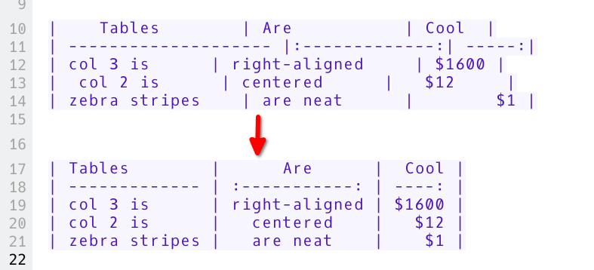
Challenges
Testing Various Kinds of PDF Loaders
Rule-Based Parsing Libraries
Why Markdown?
PyPDFLoader (Our Basic Version)
PyPDFium2Loader
Fitz
PDFPlumber
Markdown-Based PDF Exctraction
PyMuPDF4llm
LlamaParser
Markdown format can keep the structure of table data
With its header, rows, and columns
DL-Based PDF Exctraction
Unstructured.pytesseract (OCR)

Slide 30
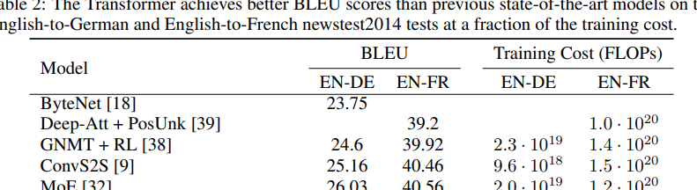
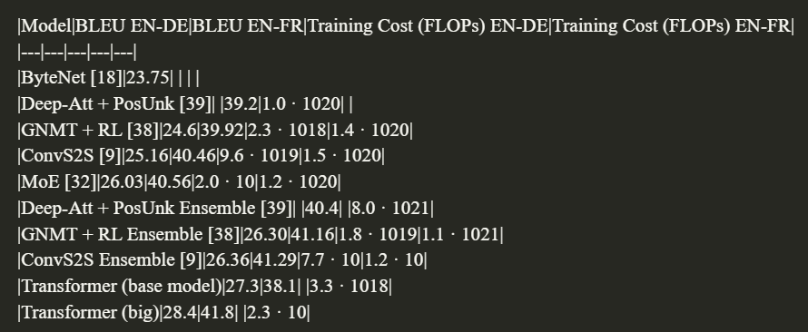

Challenges
Testing Various Kinds of PDF Loaders | LlamaParser
▲ Our testing example contains complex tabular structure
Like multi-dimension header as you can see above
All other models did not maintain the structure of the table,
but only LlamaParser parse correctly keeping the complex structure of the table !!

Slide 31

Limitations
How Can We Evaluate Our Model?
The absence of an indicator to objectively evaluate language model-based projects such as chatbots.
1
We can try evaluation by human intuition (Turing Test)
However, the evaluation results may vary from individual to individual, so it is not objective.
2
We can utilize indicators that can evaluate some features (Context Recall, Context Precision…)
Although they are not possible to evaluate the overall performance of the chatbot,
As model development advances, it is an essential problem to draw conclusions...

Slide 32
QnA

Slide 33
MIRICOMPANY
Limitations
How Can We Evaluate Our Model?
The absence of an indicator to objectively evaluate language model-based projects such as chatbots.
1
We can try evaluation by human intuition (Turing Test)
However, the evaluation results may vary from individual to individual, so it is not objective.
2
We can utilize indicators that can evaluate some features (Context Recall, Context Precision…)
Although they are not possible to evaluate the overall performance of the chatbot,
As model development advances, it is an essential problem to draw conclusions...

